Slide 1
Apportionment, Redistricting, and Gerrymandering
Asking geographic questions to address political issues

Slide 2
GeoCivics: Understanding Political Landscapes through the Humanities and Geospatial Technology
PRESENTATION LOCATION AND DATE
PRESENTER

Slide 3
What are geographic questions? See samples below, with sources to investigate.
Location and Extent
What is the phenomenon or feature of interest? What is this place like?
Where is it located? Where does it occur?
Why is it where it is? Why does it not occur elsewhere? Could it be elsewhere?
How large an area does it cover?
Distribution and Pattern or Shape
Where is it in relation to similar features?
Why does it take a particular form or structure?
What kind of distribution does it portray?
Is there regularity in its distribution? What is the nature of that regularity?
Is it found throughout the world? Where are its limits? What is the nature of those limits?
Spatial Association and Interaction
What other phenomena are in the same area?
Do phenomena usually occur together in the same area? What else is there spatially associated with that phenomenon? Why?
What is the significance of the features or location?
What are the consequences of its location and associations?
Spatial Change
Has the feature always been there? When did it first emerge or become obvious?
How has it changed spatially through time?
What factors have influenced these changes?
Why has it spread or diffused in this particular way?
What geographic factors have constrained its spread?
http://ncge.org/geography-for-life
https://www.guilford.com/books/Teaching-Geography/Phil-Gersmehl/9781462516414/reviews
https://www.nationalgeographic.org/education/programs/geo-inquiry/
Notes:
Add or subtract questions appropriate for your audience.

Slide 4
Geography is the study of places and the relationships between people and their environments. Geographers explore both the physical properties of Earth’s surface and the human societies spread across it. They also examine how human culture interacts with the natural environment, and the way that locations and places can have an impact on people. Geography seeks to understand where things are found, why they are there, and how they develop and change over time.
https://www.nationalgeographic.org/encyclopedia/geography/
https://images-na.ssl-images-amazon.com/images/I/71fUX8E%2BMGL._SX355_.jpg
Notes:
Choose a map appropriate to your audience and location.

Slide 5
Objectives and Topics
To understand the apportionment and redistricting process in the United States.
To identify the next questions to ask or actions to take regarding this topic.
Discuss the role of the decennial census in the apportionment process
Review the criteria and guidelines for drawing electoral district lines
Evaluate results of Supreme Court cases related to redistricting
Consider whether it is possible to divide a state into districts mathematically
Define gerrymandering and its positive and negative effects
Divide your state into districts based on current or future numbers of districts using 2010 Census data with geospatial technology
Know who draws the district lines in your state for US Congressional districts and state legislative districts
Consider any historical divides in your state and how they are reflected in and are affecting representative government
Discuss what else you need to know
Notes:
Delete or add objectives as appropriate for the audience.

Slide 6
Enumeration
United States Census
Notes:
A census is a count of something – pine trees / black bears / elementary students – in a geographic area. The decennial census in the United States is a count of every person, mandated by the U. S. Constitution.

Slide 7
Census Technology How to process and tabulate data
Notes:
https://www.census.gov/history/img/1890_Hollerith_Circuit-Closing_Press_OM.jpg
https://www.census.gov/history/www/innovations/technology/the_hollerith_tabulator.html

Slide 8
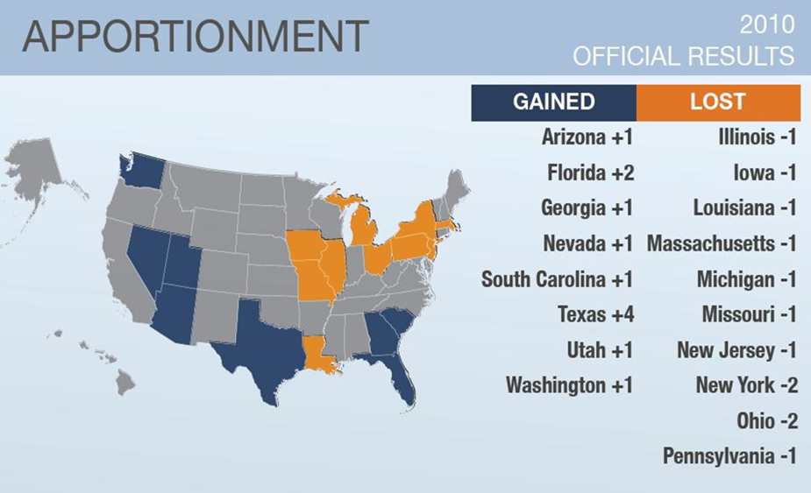

Slide 9
Apportionment
Apportionment is the first part of the process, following the reporting of the results of the Census to the United States Congress.
“Representatives and direct Taxes shall be apportioned among the several States which may be included within this Union, according to their respective Numbers.” US Constitution
Each state must have at least one representative.
Wyoming, 564,460 people per representative North Carolina, 733,499 people per representative California, 702,905 people per representative
Evolved from the Connecticut Compromise of 1787, which established equal representation in the Senate and proportional representation in the House.
Reapportionment increases or decreases the number of seats each state has in the House of Representatives.
More representation for a state means more influence in the legislature and in the presidential election cycle.
The number of representatives affects the number of electoral votes in the Electoral College.
Notes:
While the objective is to have one representative for equal numbers of individuals, in reality that does not work (compare the states listed on the slide, or change to states relevant to your region).

Slide 10
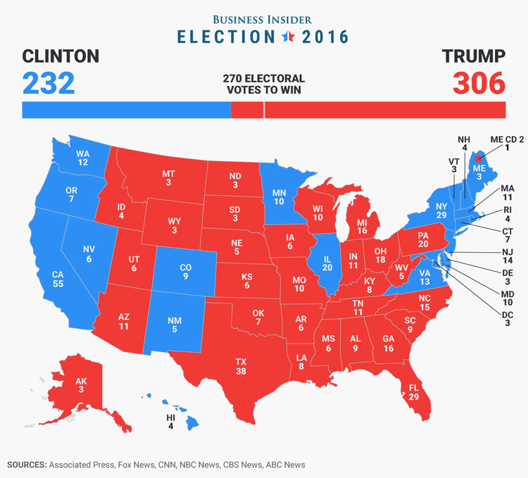
How many votes does each state have in the Electoral College?
The number of senators (2) plus the number of representatives.
https://www.google.com/search?q=electoral+college+map&tbm=isch&source=iu&ictx=1&fir=Z81kkbM0V3vmEM%253A%252C2NnKsfya-n4VjM%252C_&usg=__l6cYixbBQKVVEsfPQXMM8XOyCpY%3D&sa=X&ved=0ahUKEwjEk_v5i4naAhUKw4MKHUjIAhoQ9QEIMTAE#imgrc=R6PZaILvL_wy2M:
Notes:
Additional discussion about elections in the United States can be undertaken here.

Slide 11
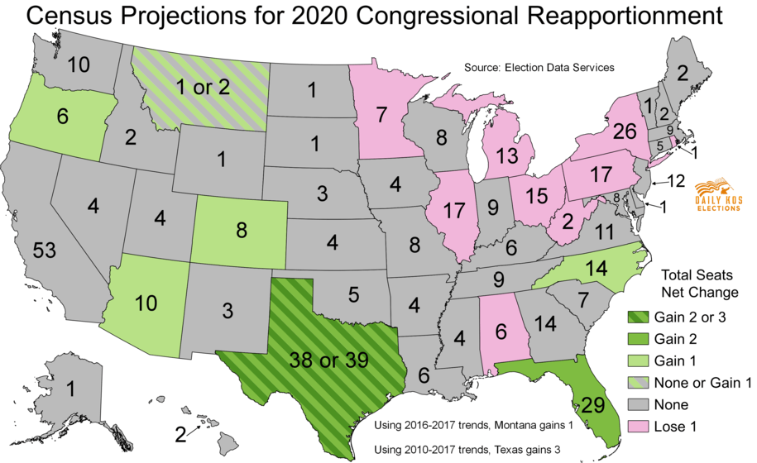
https://www.dailykos.com/stories/2017/12/21/1726412/-New-census-data-projects-which-states-could-gain-or-lose-congressional-seats-in-2020-reapportionment
Notes:
Note that these are only predictions, but that they are based on updated Census survey information. This is an opportunity to discuss the difference between a survey and a census. “A survey is a data collection activity involving a sample of the population. A census collects information about every member of the population.” https://cber.cba.ua.edu/asdc/census_survey.html

Slide 12
Redistricting
Redrawing of the boundaries of the districts within each state based on census results
Follows the process of reapportionment
States gaining or losing significant population in comparison to other states will have more changes than those that are stable
District boundaries may also change due to population migration within a state
Congressional district lines are also used to define other political and economic regions, such as state university regents and state school board members.
Notes:
Change the map of the state as necessary. What other activities in your state reference congressional district lines? Remember, members of Congress are also authorized to make recommendations to US service academies. Geography question - would the regions be formal, functional, or perceptual?

Slide 13
Layers of the Laws of Redistricting
Voting Rights Act
Competitive
Respect Communities of Interest
Maintain Political Subdivisions
(counties, cities, special districts)
Compactness
Contiguity
One Person, One Vote = Equal Population
Notes:
See the flashcards in the drawthelinespa Teacher Toolkit for another method of discussing these topics. https://drawthelinespa.org/teacher-toolkit/teacher-toolkit-nu/teacher-toolkit-basic

Slide 14
Importance of Fair Representation and Transparency
Notes:
Discuss the 2010 Utah case study: https://www.esri.com/en-us/arcgis/products/esri-redistricting/overview/redistricting-utah-case-study. Review issues in Wisconsin: https://www.wisdc.org/reforms/support-fair-voting-maps. Does gerrymandering only take place at the federal level or can it happen at the state and local levels as well?

Slide 15
What exactly are we trying to equalize?
Voters People
Each vote should
have equal weight
Equal numbers of people should have equal representation
Joseph Fishkin, Geometry of Redistricting Workshop, 2/4/18
Notes:
All people must be counted in order to determine representation.

Slide 16
Voting Systems
First-past-the-post – plurality or majority
Ranked choice
Proportional representation
Semi-proportional systems
Notes:
The way it has always been done is not necessarily best for going forward. If this topic is of interest to your audience, suggest several resources for examining alternative voting systems. It would be particularly beneficial to read information from other countires.
http://www.ncsl.org/research/elections-and-campaigns/alternative-voting-systems.aspx
https://www.fairvote.org/types_of_voting_systems
https://www.electoral-reform.org.uk/voting-systems/
https://ottawacitizen.com/opinion/columnists/electoral-reform-five-different-voting-systems-at-a-glance

Slide 17
Selected Supreme Court Cases
Baker v. Carr (1962)
Federal courts have jurisdiction to consider constitutional challenges to state legislative redistricting plans.
Gray v. Sanders (1963)
Established the constitutional standard for equality of representation as “one person, one vote.”
Reynolds v. Sims (1964)
Legislative districts may deviate from strict population equality only as necessary to give representation to political subdivisions and provide for compact districts of contiguous territory.
Thornberg v. Gingles (1986)
created the standard for determining whether § 2 of the Voting Rights Act requires that a majority-minority district be drawn.
Shaw v. Reno (1993)
Legislative and congressional districts will be struck down by courts for violating the Equal Protection Clause if they cannot be explained on grounds other than race. While not dispositive, “bizarrely shaped” districts are strongly indicative of racial intent.
Arizona State Legislature v. Arizona Independent Redistricting Commission (2015)
Creation of a redistricting commission for congressional districts via ballot initiative does not violate the Elections Clause of the U.S. Constitution.
Evenwell v. Abbott (2016)
Total population is a permissible metric for calculating compliance with “one person, one vote.”
Notes:
For additional details and up-to-date decisions, investigate these resources:
http://www.ncsl.org/research/redistricting/redistricting-and-the-supreme-court-the-most-significant-cases.aspx
https://constitutioncenter.org/learn/educational-resources/
https://www.brennancenter.org/issues/redistricting

Slide 18
Recent Decisions
Include current discussions here

Slide 19
Gerrymandering

Slide 20
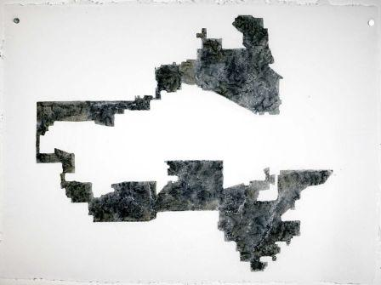
What do you see?
In a few words, describe this shape.
Notes:
20

Slide 21
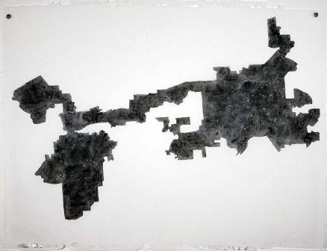
What do you see?
In a few words, describe this shape.
Which direction is north? east or west?
Notes:
21

Slide 22
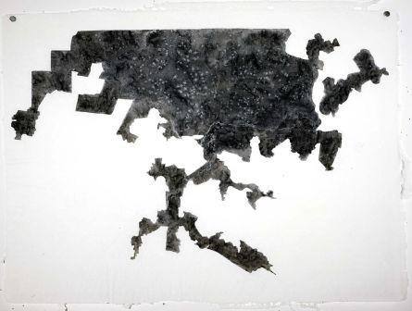
What do you see?
In a few words, describe this shape.
Which direction is north? east or west?
Are all of the edges of the shape straight or curvy? Hypothesize why the edges are drawn this way.
Notes:
22

Slide 23
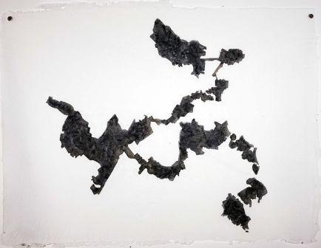
What do you see?
This series by Jina Valentine is an examination of the forms of massively gerrymandered districts; they look like Rorschach Tests.
Jina Valentine is an Assistant Professor of Art at the University of North Carolina – Chapel Hill. She is a contemporary visual artist whose work is informed by the techniques and strategies of American folk artists. She uses a variety of media to weave histories – including drawing, papermaking, found-object collage, and radical archiving.
Notes:
23
For more information about the artist, visit: https://www.wral.com/with-paper-and-ink-jina-valentine-delves-below-the-surface/16772189/

Slide 24
Civic Landscapes
What is the primary message of this political cartoon?
What region of the United States does this cartoon represent? What clues does the cartoon give you?
What additional information do you need to interpret this image?
Notes:
24
For more details about how to interpret primary sources, visit the Arizona Geographic Alliance website: https://geoalliance.asu.edu/geolens. Examine the original newspaper with this cartoon: https://blogs.loc.gov/law/2017/02/elbridge-gerry-and-the-monstrous-gerrymander/

Slide 25
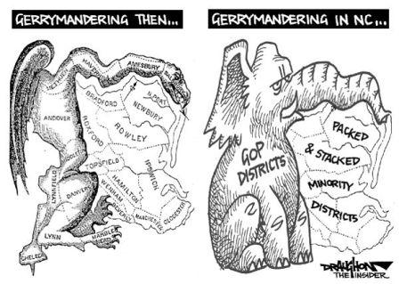
Gerrymandering
Gerrymandering refers to the drawing of political boundaries in favor of one party, or faction, over another.
The term was derived from the name of Governor Elbridge Gerry of Massachusetts, whose administration enacted a law in 1812 defining new state senatorial districts. Newspaper editors combined with his name with “salamander”, which is what they thought one of the districts looks like.
Dennis Draughton (2011)
Notes:
25

Slide 26
How would you draw the lines to be fair?
It’s all in the math!
In the second and third images, count the red and blue squares surrounded by the bold black lines (simulated districts).
Which districts will vote red and which will vote blue?
Notes:
26

Slide 27
Manipulation of Voters
Negative
Positive
“The gerrymander is used as a gadget to concentrate the strength of the opposition party in as few districts as possible, creating many inequities in representation as well as some geographic monstrosities.” (Binkley and Moos 1952, 819).
Construction of districts provides minority voice in legislative body.
Notes:
Use this information as a starting point for additional discussion about the positive and negative effects of drawing electoral district lines with a particular purpose in mind.

Slide 28
Remember the Laws of Redistricting
Partisan Gerrymandering
Voting Rights Act
Respect Communities of Interest
Maintain Political Subdivisions
(counties, cities, special districts)
Compactness
Contiguity
One Person, One Vote = Equal Population

Slide 29
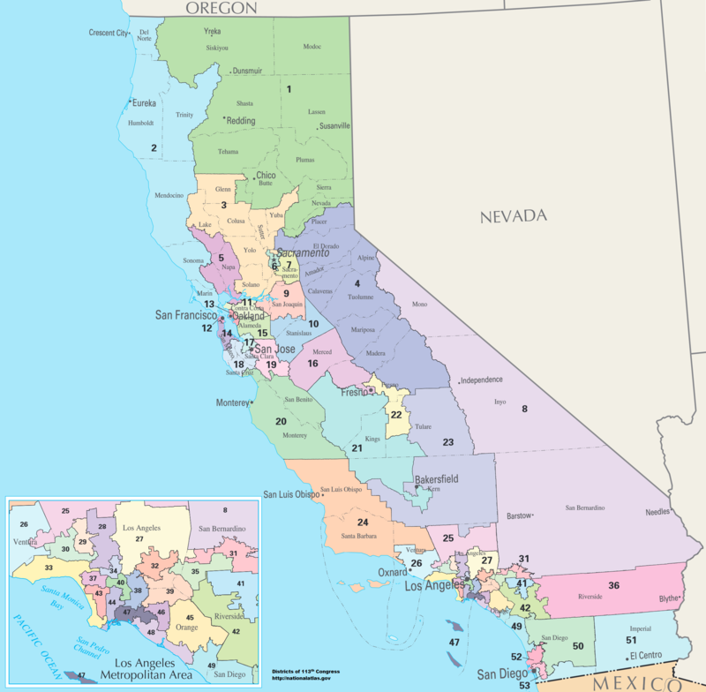
How to draw a district
What kinds of factors do you think politicians used in drawing these lines?
Would it be more complicated to draw districts in the Los Angeles region than in rural areas?
By Department of the Interior - National Atlas of the United States (http://nationalatlas.gov/printable/congress.html), Public Domain, https://commons.wikimedia.org/w/index.php?curid=30930529
Notes:
29
Substitute your state as appropriate. This is an opportunity to discuss the value of using an inset map. https://definedterm.com/inset_map

Slide 30
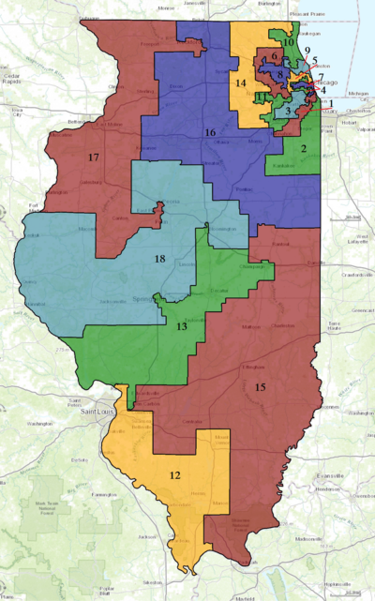
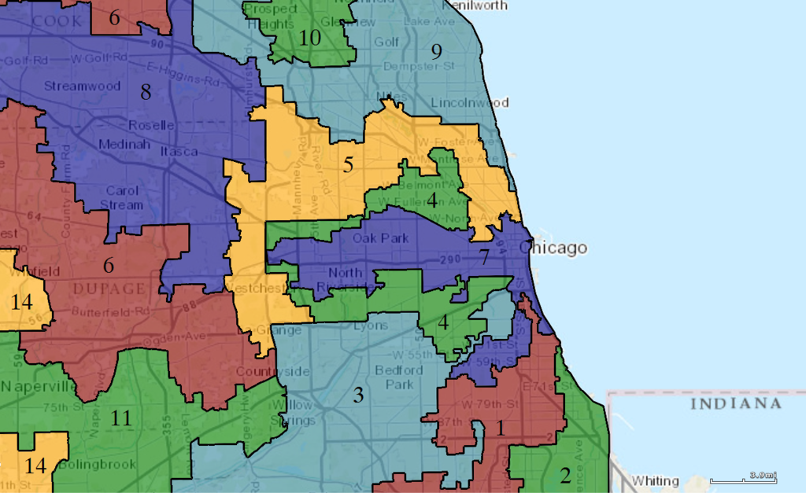
Scales of Gerrymandering District, Region, State
How have modern computer technologies, including survey data and geographic information science (GIS), affected the process of drawing electoral district lines?
By Authors: 1) All GIS data presented in this project was originally collected and published by the United States Department of the Interior. 2) US district GIS shapefile data created in association with the UCLA by Jeffrey B. Lewis, Brandon DeVine, Lincoln Pitcher, and Kenneth C. Martis. (2013) Digital Boundary Definitions of United States Congressional Districts, 1789-2012. 3) Data was rendered using ArcGIS® software by Esri. 4) File developed for use on Wikipedia and elsewhere by 7partparadigm. - US Department of the Interior, public data retrieved from http://cdmaps.polisci.ucla.edu, Public Domain, https://commons.wikimedia.org/w/index.php?curid=37189703
Notes:
The effects of social media could also be discussed.

Slide 31
Packing and Cracking
“Standard gerrymandering techniques [are] known as packing and cracking. Packing means massing the bulk of the opposing party’s voters into a very few districts, which are effectively conceded to opposing party candidates. Cracking means dispersing the rest of the opposing party’s voters into the remaining districts, where they are expected to be a permanent minority. By creating many more cracked districts than packed districts, the party in charge of redistricting hopes to achieve enduring control of the legislative body.” - Roger Parloff
https://www.yahoo.com/news/packing-cracking-supreme-court-takes-partisan-gerrymandering-090050994.html?_tsrc=jtc_news_index

Slide 32
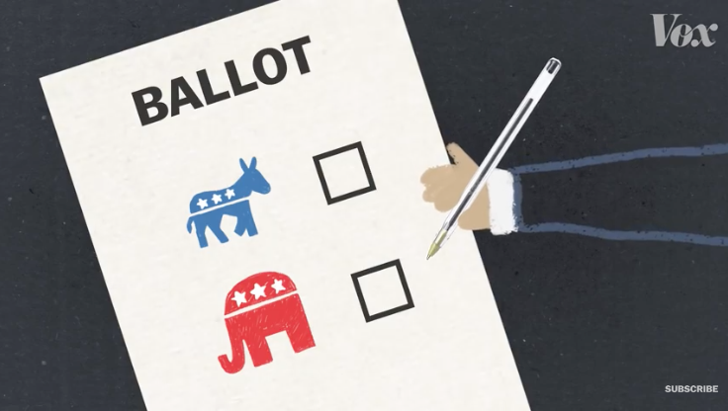
Gerrymandering and How to Fix It
Which of these goals do you agree with?
It seems like a system should offer partisan fairness such that control of a legislature is typically in line with the population’s overall preference.
Districts should align communities of interest and correspond in some sense to real places that we can characterize, like “the South Side of Chicago,” rather than just be arbitrary zones
Racial minority groups should get fair representation. A state like Georgia that’s 30 percent black shouldn’t have an all-white congressional delegation.
There should be fair-fight districts with real electoral competition, not just everyone segregated into safe seats that protect incumbents.
Districts should be compact and look like a nice checkerboard of squares and triangles, rather than a bunch of crazy squiggles.
https://www.vox.com/policy-and-politics/2017/10/11/16453512/gerrymandering-proportional-representation
Notes:
32
Discuss how many experts believe that gerrymandering has contributed to the extreme polarization between political parties today because gerrymandering diminishes the influence of moderates.
https://www.brookings.edu/blog/brookings-now/2017/07/06/a-primer-on-gerrymandering-and-political-polarization/

Slide 33
Mathematicians are thinking about approaches to redistricting
When is your vote a deciding vote? Is the district skewed? How spread out or sprawling is the district?
“The probability of a tie vote in the cracked district is φ(.5K/σ)/σ. So, the formula for the deciding vote percentage is: (Φ(.5K/σ)(1−Φ(−K/σ)) + (1−Φ(.5K/σ))Φ(−K/σ))φ(.5K/σ)/σ.”
Michael Nahas, October 26, 2017
How to Make Optimal Maps with Bias - construct N districts of equal population according to µ, but restricting amount of µB and µR in each district
Nestor Guillen, University of Massachusetts
Valence – allow districts to overlap
Lucius Schoenbaum, University of South Alabama
1. Take a disaggregated map
2. Use an algorithm to randomly generate lots of legally valid redistricting plans by combining pieces of the state
3. Calculate partisanship of generated plans
4. Calculate partisanship of actual plan and compare
Scott T. Macdonell, CNA
Notes:
There are many resources devoted to this topic. If audience members are interested in exploring these materials, suggest these websites.
https://mggg.org/
https://www.ams.org/publicoutreach/mathmoments/mm132-gerrymandering-podcast
https://sinews.siam.org/

Slide 34
Suppose you are given a candidate map of congressional districts for a state. How can you tell if this map is a partisan gerrymander?
Importance of Compactness
1. Any shape constraints generally limit the power of the map-drawer
2. Extreme gerrymandering requires eccentrically shaped districts
Already a key factor – districts must be contiguous
Eye-test does not always work due to sophisticated mapping techniques
Notes:
Emphasize the importance of understanding on-line mapping technologies. There is no objective test or analysis at this time for identifying a gerrymandered district.

Slide 35
Lulac v. Perry (2006)
League of United Latin American Citizens v. Perry, 548 U.S. 399 (2006), is a Supreme Court of the United States case in which the Court ruled that only District 23 of the 2003 Texas redistricting violated the Voting Rights Act. The Court refused to throw out the entire plan, ruling that the plaintiffs failed to state a sufficient claim of partisan gerrymandering.
The opinion requires lawmakers to adjust Congressional district boundaries in comport with the Court's ruling, though the ruling does not threaten Republican gains as a result of the redistricting in Texas. The Court also declined to resolve a dispute over whether partisan gerrymandering claims present nonjusticiable political questions.
Notes:
35

Slide 36
Current Events and
Congressional Representation
District 23 was determined to be in violation of the Voting Rights Act and was redrawn.
Look at the location of this district. What important role might this district play in 2019?
What are practical implications of these district lines on future issues?
Notes:
36

Slide 37
Conclusion and Next Steps
apportionment and redistricting in the United States
To identify the next questions to ask or actions you would like to take regarding this topic.
Data collected during the decennial census determines how many representatives each state will have in the United States House of Representatives.
State legislators are responsible for the criteria and guidelines for drawing electoral district lines
Many Supreme Court cases have addressed the redistricting process.
At this time, there are no objective analysis tools for determining whether a district has been manipulated.
Gerrymandering has positive and negative effects.
Divide your state into districts based on current or future numbers of districts using 2010 Census data with geospatial technology.
Know who draws the district lines in your state for US Congressional districts and state legislative districts.
Consider any historical divides in your state and how they are reflected in and are affecting representative government.
Discuss what else you need to know.
Notes:
Go to the State Resources page on the GeoCivics website to access your state’s redistricting exercise.
https://www.uccs.edu/geocivics/stateresources

Slide 38
Questions?
Next steps?
Notes:
Replace this image with the National Geographic Giant Map of your state. Provide additional instructions as needed

Slide 39
Find additional resources on the GeoCivics website.
Contact us with any inquiries:
Rebecca Theobald, geocivics50@gmail.com
Andy Mink, amink@nationalhumanitiescenter.org
Anita Palmer, anita@gisetc.com
Saskia van de Gevel, gevelsv@appstate.edu
https://www.uccs.edu/geocivics/

